Slide 1
Realtime Graphics
Guest lecture in “Datorgrafik med Interaktion”
by Mikael Kalms

Slide 2



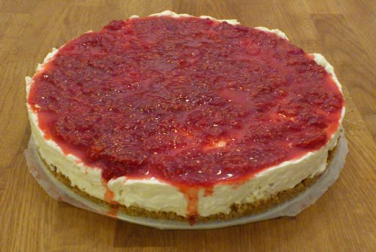
Me.

Slide 3
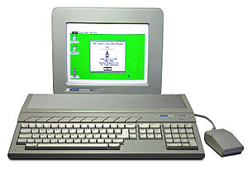
My formative years

Slide 4
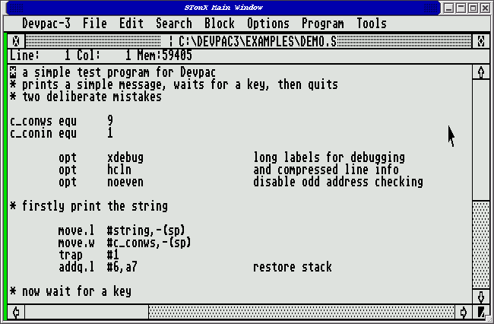
My first assembler

Slide 5

Oups.

Slide 6
Back then, this was cool:

Slide 7
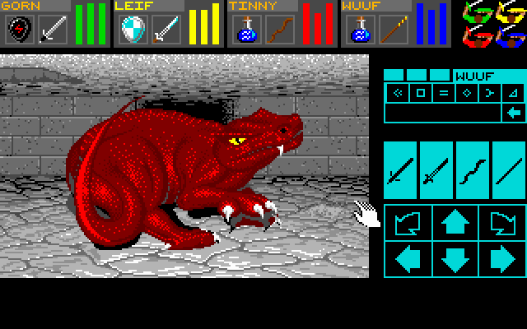
Back then, this was fresh:

Slide 8
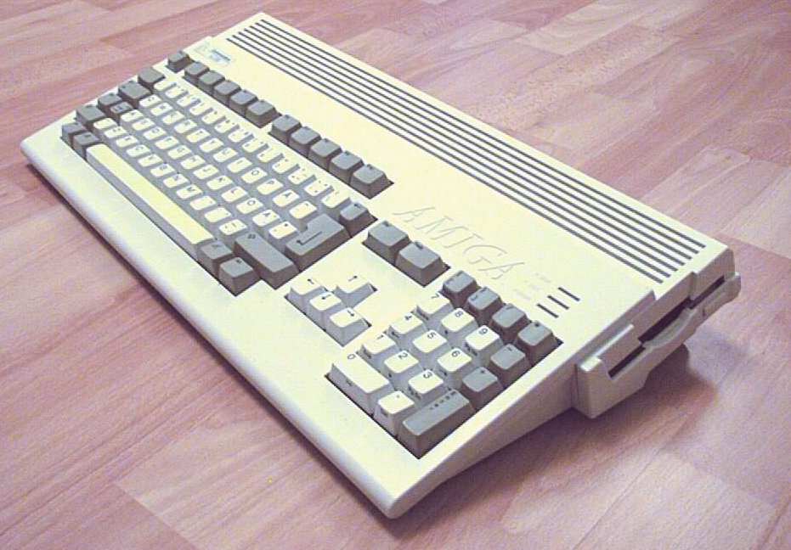
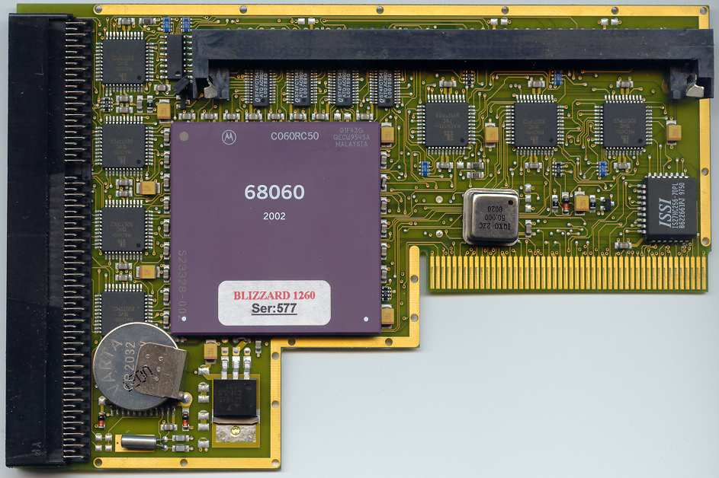
My machine of choice since 1994
+
50MHz CPU
64MB Main Memory
2MB Video Memory
Typical display resolution: 320x256 pixels, 256 simultaneous colours
No 3d hardware whatsoever

Slide 9
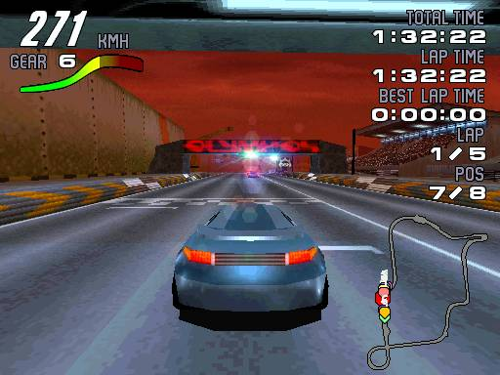

I've worked on games.

Slide 10
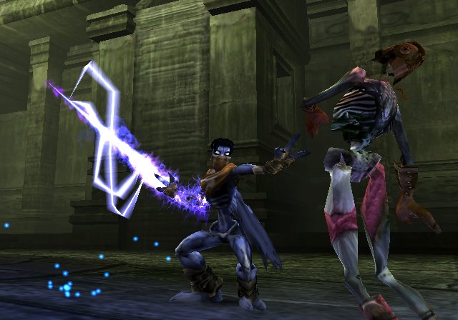
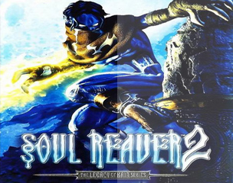
I've worked on games.

Slide 11

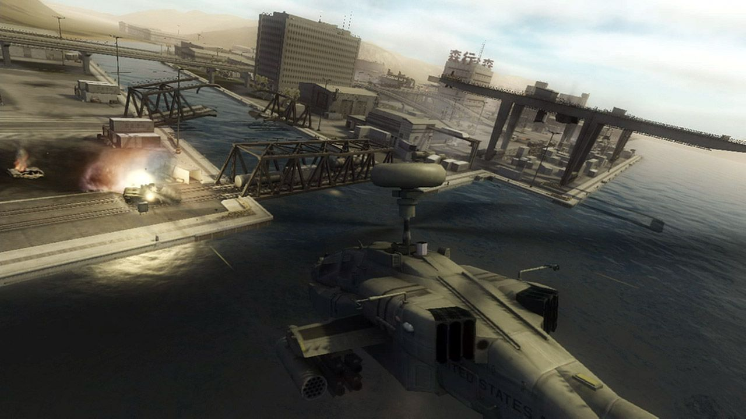
I've worked on games.

Slide 12

I've worked on games.

Slide 13
But, back on topic.

Slide 14
Characteristics of realtime graphics
10-100 images/second generated (so: high throughput)
If it's interactive, then latency is also important
Minimum performance is important; it is often better to have consistent performance, than high peak performance

Slide 15
My approach to realtime graphics programming
50% play around
50% directed work

Slide 16
My choice of language: C++
Why?
“the most advanced assembler on the market”
Available on nearly all machines
Can talk directly to the OS
Control over memory usage
Control over CPU usage
No garbage collection
You can use other languages too, but then you are limiting yourself in some ways.

Slide 17
Things to come
Before the break, we will discuss...
Our test harness.
Image processing.
Image bending.

Slide 18
A. Our test harness
Blank canvas
What's an Image?
What's a FloatRGBColor?
How do RGB colors work?
How do I draw a pixel?

Slide 19
Image coordinate system
(0, 0)
Increasing X
Increasing Y
Offset: width * y + x
Row 0
Row 1
Row 2
Row 3
Row 4
Row 5

Slide 20
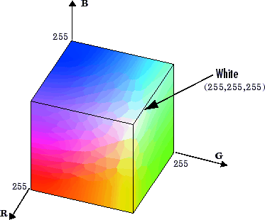
What's a an RGB color?
A triplet of color intensities (Red / Green / Blue)
Can be seen as “a vector in the RGB color space”
Or, a position in the
“color cube”

Slide 21
B. Image processing
Displaying an image.
Computations on color values.
Computations on color components.
FIR low pass filter.
IIR low pass filter.

Slide 22
FIR Filter
Output pixel = weighted combination of some neighbouring input pixels
y[n] = x[n-2] * k0 + x[n-1] * k1 + x[n] * k2 + x[n+1] * k3 + x[n+2] * k4

Slide 23
IIR Filter
Output pixel = weighted combination of some neighbouring input pixels AND some neighbouring input pixels
y[n] = y[n-1] * k0 + x[n-1] * k1 + x[n] * k2 + x[n+1] * k3

Slide 24
C. Image bending
How do we scroll an image?
Per-line distortion.
Image zooming (map source → dest)
Image zooming (map dest → source)

Slide 25
Conclusions from image zoomer
Mapping dest → source is usually better when doing image manipulation!

Slide 26
Relax.
It's break time.
Regroup in 15.

Slide 27
Things to come
Rendering filled shapes...
… using per-pixel test
… using scanconversion
… using spantables
And then, filling the shapes with interesting bits
Finally, let's do something interesting with our tools.

Slide 28
E. Per-pixel test
How do we draw a circle?
Drawing a halfspace.
Drawing a triangle.

Slide 29
Circle equation
x² + y² <= r²
Example:
(x-x0)² + (y–y0)² <= r²
with:
x0 = 5
y0 = 4
r = 2

Slide 30
Halfspace equation
Ax + By + C >= 0
Example:
Ax + By + C >= 0
with:
A = -2
B = -1
C = 10

Slide 31
Halfspace vs hyperplane
Hyperplane = point (1D), line (2D), plane (3D)
A hyperplane divides space into two halfspaces
This is a halfspace
Another halfspace
This is a hyperplane

Slide 32
Triangle equation set
Set up one halfspace equation per edge.
If halfspace1 && halfspace2 && halfspace3 holds, then (x,y) is inside the triangle.

Slide 33
F. Scanconversion / spantables
Why scanconversion?
Draw circle using scanconversion.
Draw triangle using scanconversion.
Draw triangle using spantables.

Slide 34
Why scanconversion?
Take advantage of correlation between neighboring pixels → performance
Also – it expands your mind

Slide 35
Circle scanconversion
(x-x0) = ±(r² – (y-y0)²)^{1/2}
Example:
x = x0 ±(r² – (y-y0)²)^{1/2}
with:
x0 = 5
y0 = 4
r = 2

Slide 36
Triangle scanconversion

Slide 37
G. Shading our triangles
Gouraud shaded triangle
Texturemapped triangle

Slide 38
Gouraud shading
Specify colour values at each vertex in triangle
Linearly interpolate colour values within triangle
Linear gradients!

Slide 39
Texture mapping
Specify texture coordinates at each vertex in triangle
Linearly interpolate texture coordinates within triangle
Linear gradients!
At each pixel, lookup color from texture (at the current texture coordinate)

Slide 40
H. Using our texturemapper
Zoomrotator.
Image distorter.
Tunnel.

Slide 41
The end.
Questions?
Reach me at: mikael@kalms.org

